Slide 1
Affective Haptics for Mobile Devices
Chris Ullrich
3/4/12

Slide 2
Affective Haptics: A Commercial Perspective
Immersion UX and R&D
  Focus is on value and commercial haptic rendering
Key questions
  How to best characterize end user satisfaction?
  How to enable emotional haptics on commodity platforms?

Slide 3
Overview
Motivation for Affective Haptics
Early work
Design research
Current work
Open questions

Slide 4
Motivation

Slide 5

© 2011 Immersion Corporation
© 2011 Immersion Corporation

Slide 6
make contact with
how does that grab you?
keep in touch
a clinging personality
put on the finishing touches
a gripping experience
he’s tactful
she’s tactless
a hands-off policy
itching to go
like a kick in the teeth
a touching experience
get a grip
only scratched the surface
solid reputation
she’s touchy
can you handle it?
makes my skin crawl
s t r e t c h the imagination
i feel edgy
hold your own
a palpable lie
standing on pins and needles
grasp an idea
touch and go
don’t be pushy
a slimy character
he rubs me the wrong way
the personal touch
walking on egg shells
i’m deeply touched
be on your toes
a rough character
a mere slap on the wrist
like a slap in the face
[2]
© 2011 Immersion Corporation

Slide 7
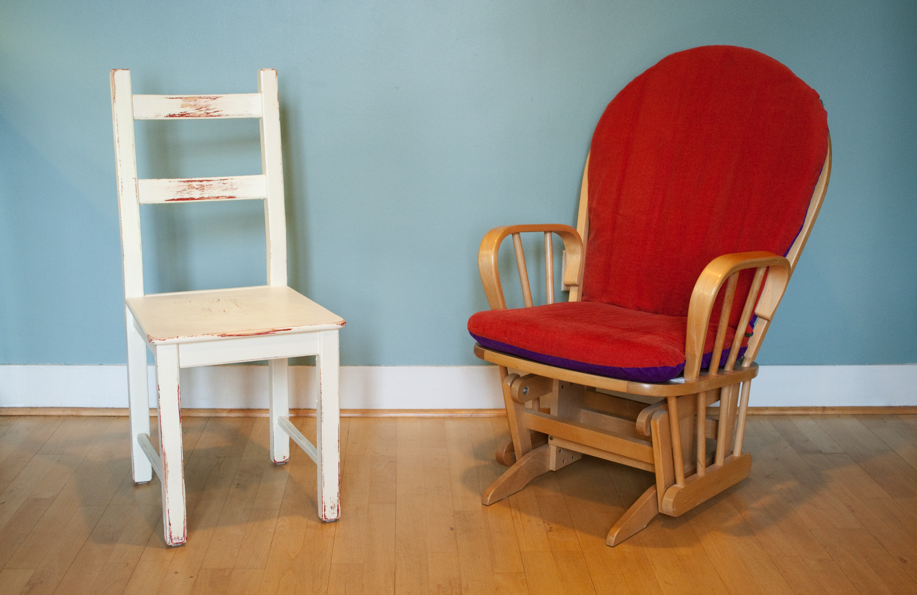
© 2011 Immersion Corporation

Slide 8

© 2011 Immersion Corporation
© 2011 Immersion Corporation

Slide 9
Affective Haptic Research 2005-2011

Slide 10
Early Work in Mobility – 2005 - 2008
Feature phone platform
  Alerts and ringers
  Games (J2ME)
Can SMS be haptically enhanced to
generate emotional response?
  Approach:
    Symbol mapping based hapticons
  User responses
    Experience too abstract
    Very limited number of comprehensible hapticons in SMS
    Except for heartbeat, user perception was confusion
  Conclusion
    Haptic feedback too abstract to effectively convey emotional meaning
    Focus on vibration ringtones for platform value
Symbol | Hapticon
:-) | Ramp up
;-) | Ramp up + pop
<3 | Heartbeat
… | …

Slide 11
Emotional Haptic Design – 2008-2011
Smartphone platform (post iPhone)
  Powerful CPU and sensing capabilities
  Advanced haptics (LRA, ERM)
Can smartphones with advanced haptics enable or enhance emotional connection?

Slide 12
Design Research Process
Identify underserved user needs
Define opportunity areas
Here’s what we can do about it
Here’s how it could look

Slide 13
Subjects
Recruiting Strategy
Identify target demographics
Recruit ‘extreme’ users to amplify underserved needs

Slide 14
“There’s no substitute for human touch.”
“In person you can look in their eyes, see their mannerisms.”
“Sometimes you want to keep in touch but you have nothing to write.”
Dave, 52, Firefighting Captain
“I could have avoided a fight by touching her hand.”
Sue, 57, Business Power User
Nauremon, 28, Early Adopter & Blogger
Tony, 42, Tour Guide & Rock Promoter
© 2011 Immersion Corporation
© 2011 Immersion Corporation

Slide 15
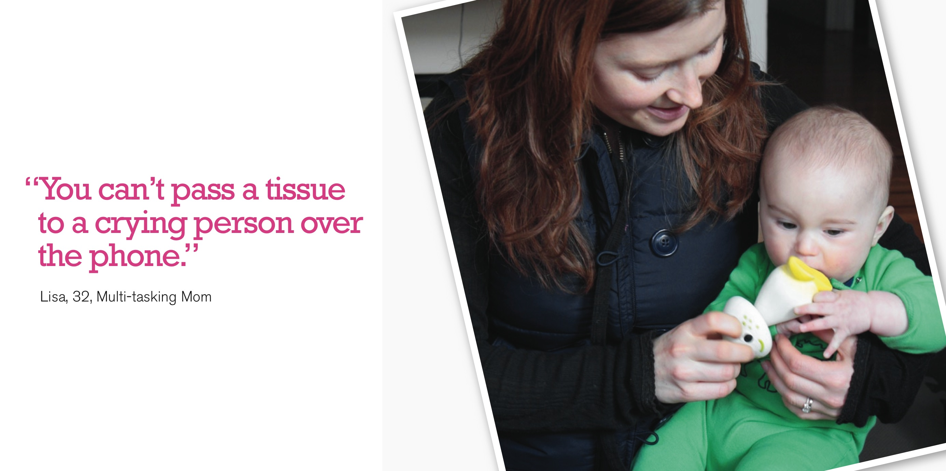

Slide 16
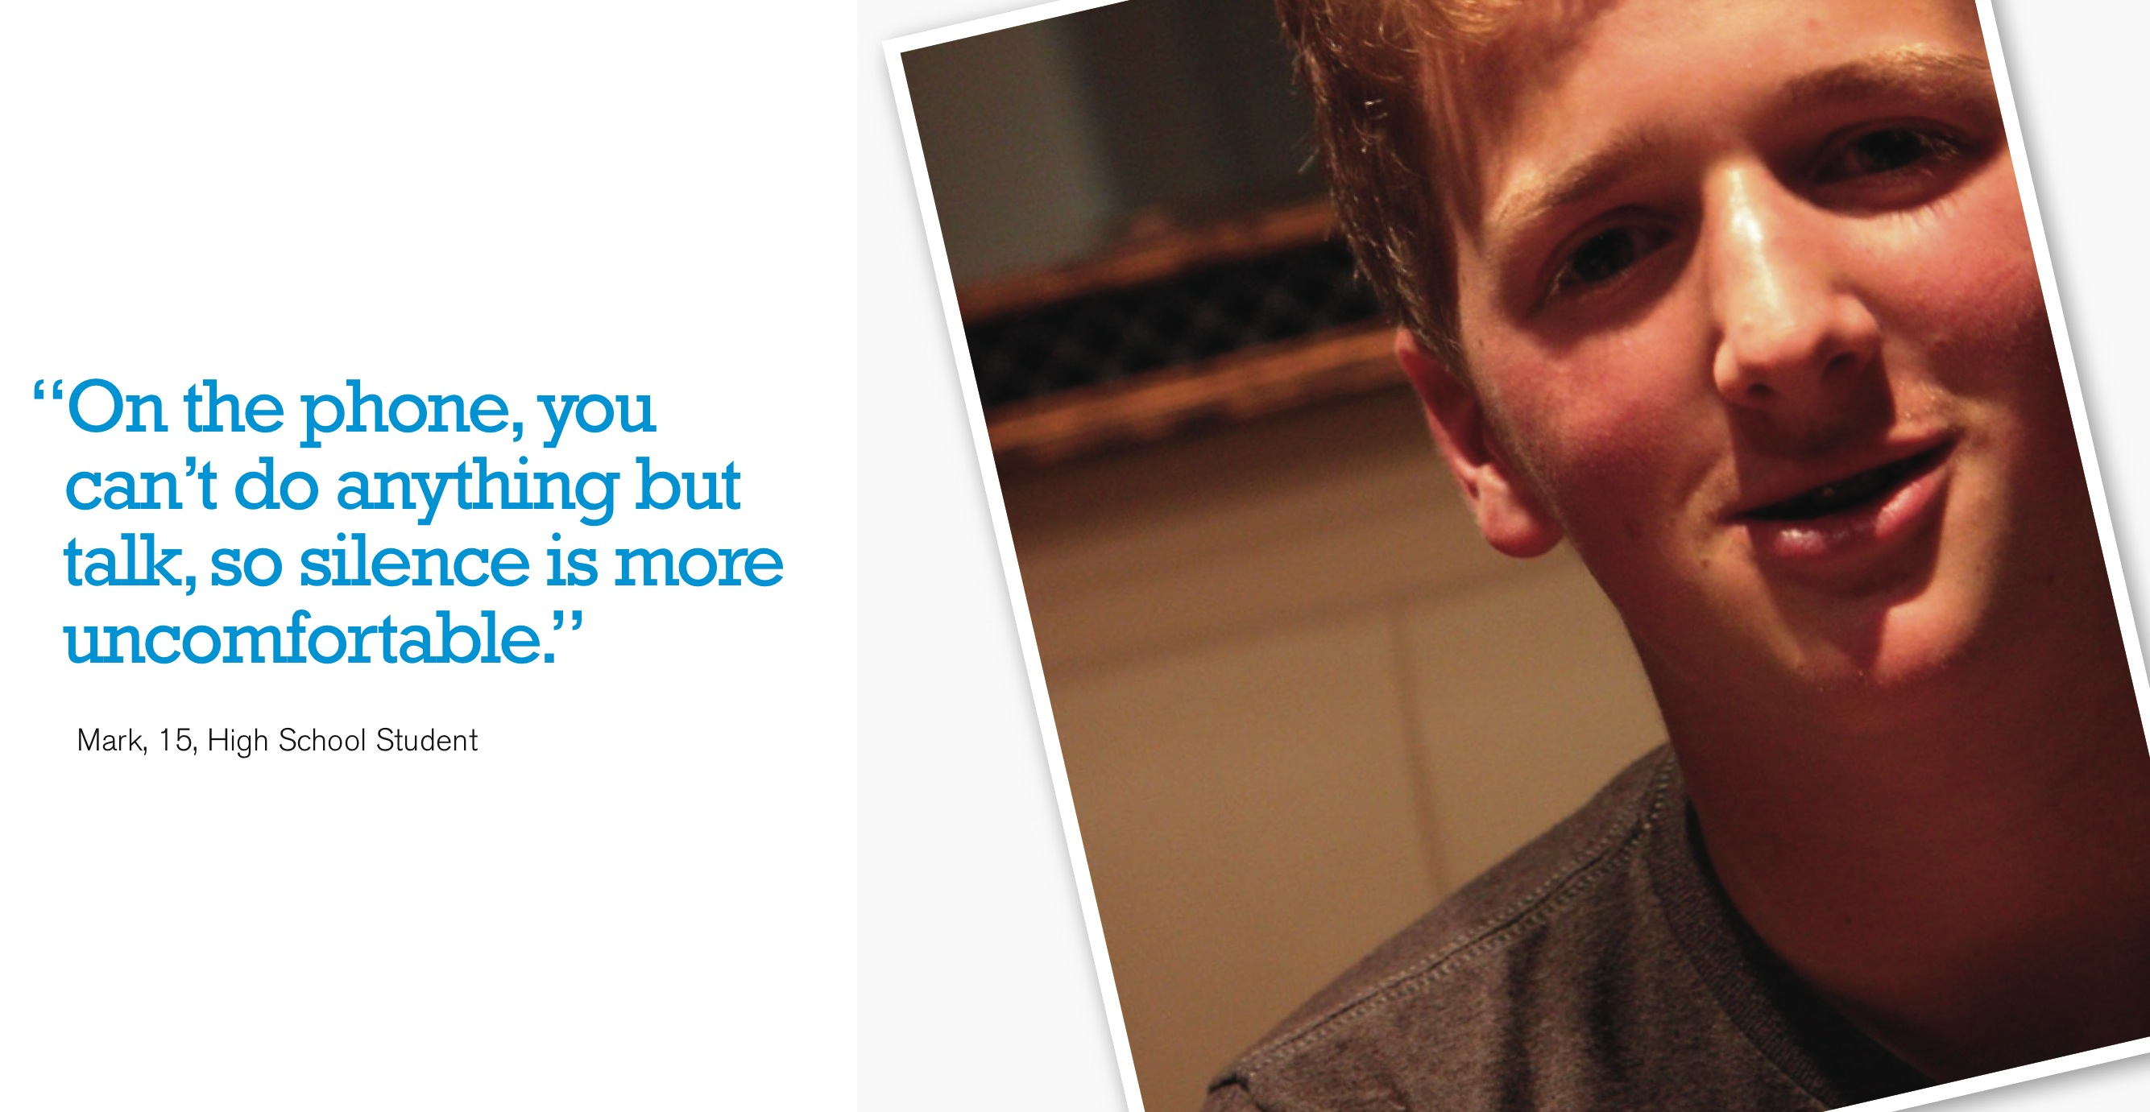

Slide 17
Opportunity Areas
Communicate intent of incoming messages
Give People a sense of shared space

Slide 19
Use Case: Craft Your Tap
Prototype
  Tactile authoring based on screen tap duration
Observations
  Slightly improved response but sensing and actuation technologies not sufficient to convey real emotion without context
  In-context perceived value is high
  Inverse relationship between haptic fidelity and need for multimodality

Slide 20
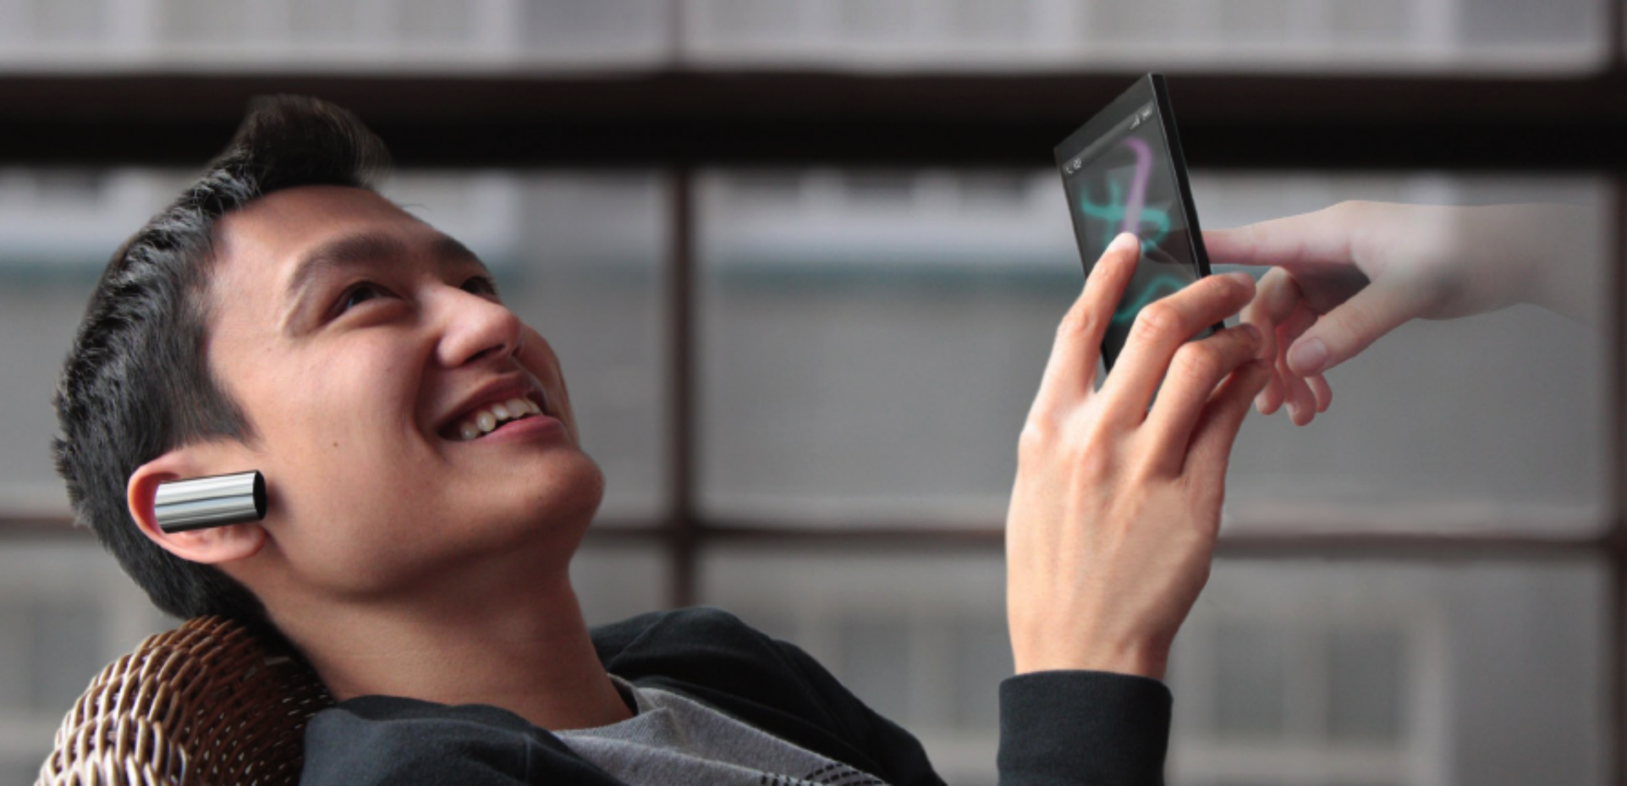
“When our fingertips cross paths, she doesn’t feel so far away.”
© 2011 Immersion Corporation

Slide 21
Use Case: Touch Trails
Prototype
  Two phones each with ERM motors
  Shared space app
  Simple tactile feedback but real-time
Observations
  Strong emotional reaction
  Smiles, engagement, ‘need to take a shower’
  Users creeped out when interacting with strangers

Slide 22
Touch Trails Video
© 2011 Immersion Corporation

Slide 24
Frostbox
Prototype
  HD phone prototype
  Frostbox application
Observations
  Couples and close friends immediately used it for playful, affective interactions
  Idiosyncratic doodles -> emotional connection

Slide 25
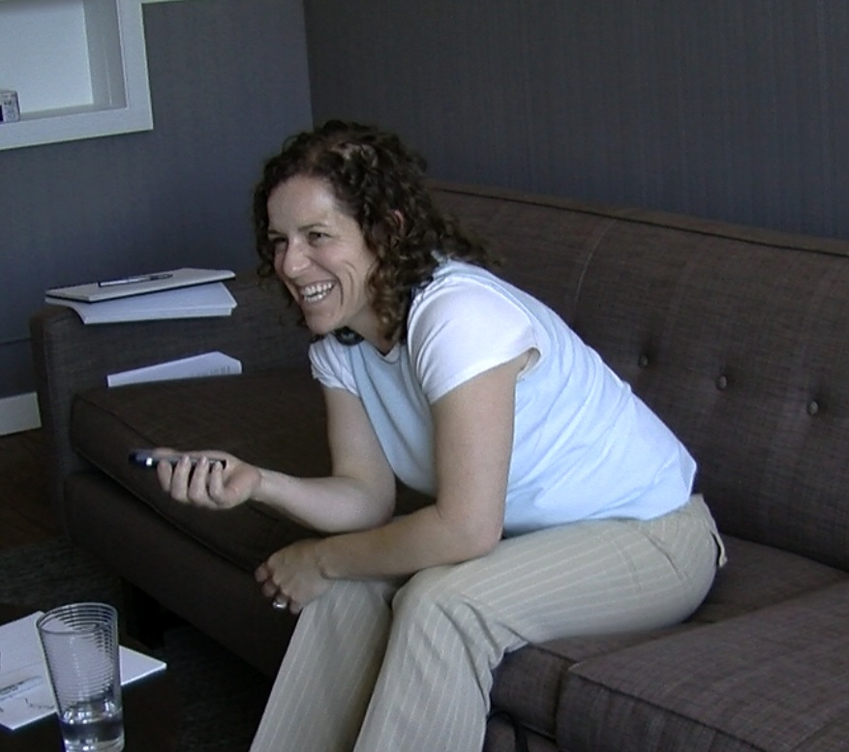
“It feels like they’re drawing on your hand,
so it’s like they’re in the room with me.”
Andrea

Slide 26
Current Research

Slide 27
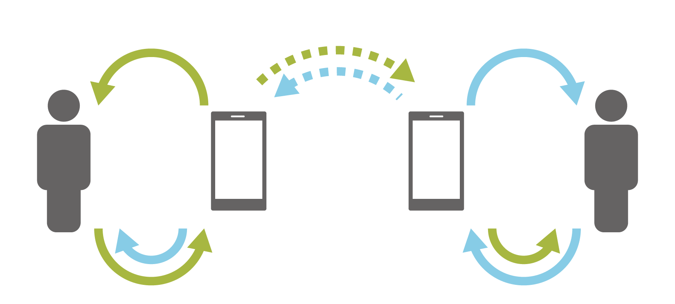
Current Work - 2012
Tactile User Interface

Slide 28
REAL PERFORMANCE
Standard touchscreen
Tactile touchscreen
Physical keyboard
Slow & error-prone
Fast & accurate
PERCEIVED PERFORMANCE
Standard touchscreen
Tactile touchscreen
Physical keyboard
Slow & error-prone
Fast & accurate
[5]
© 2011 Immersion Corporation

Slide 29
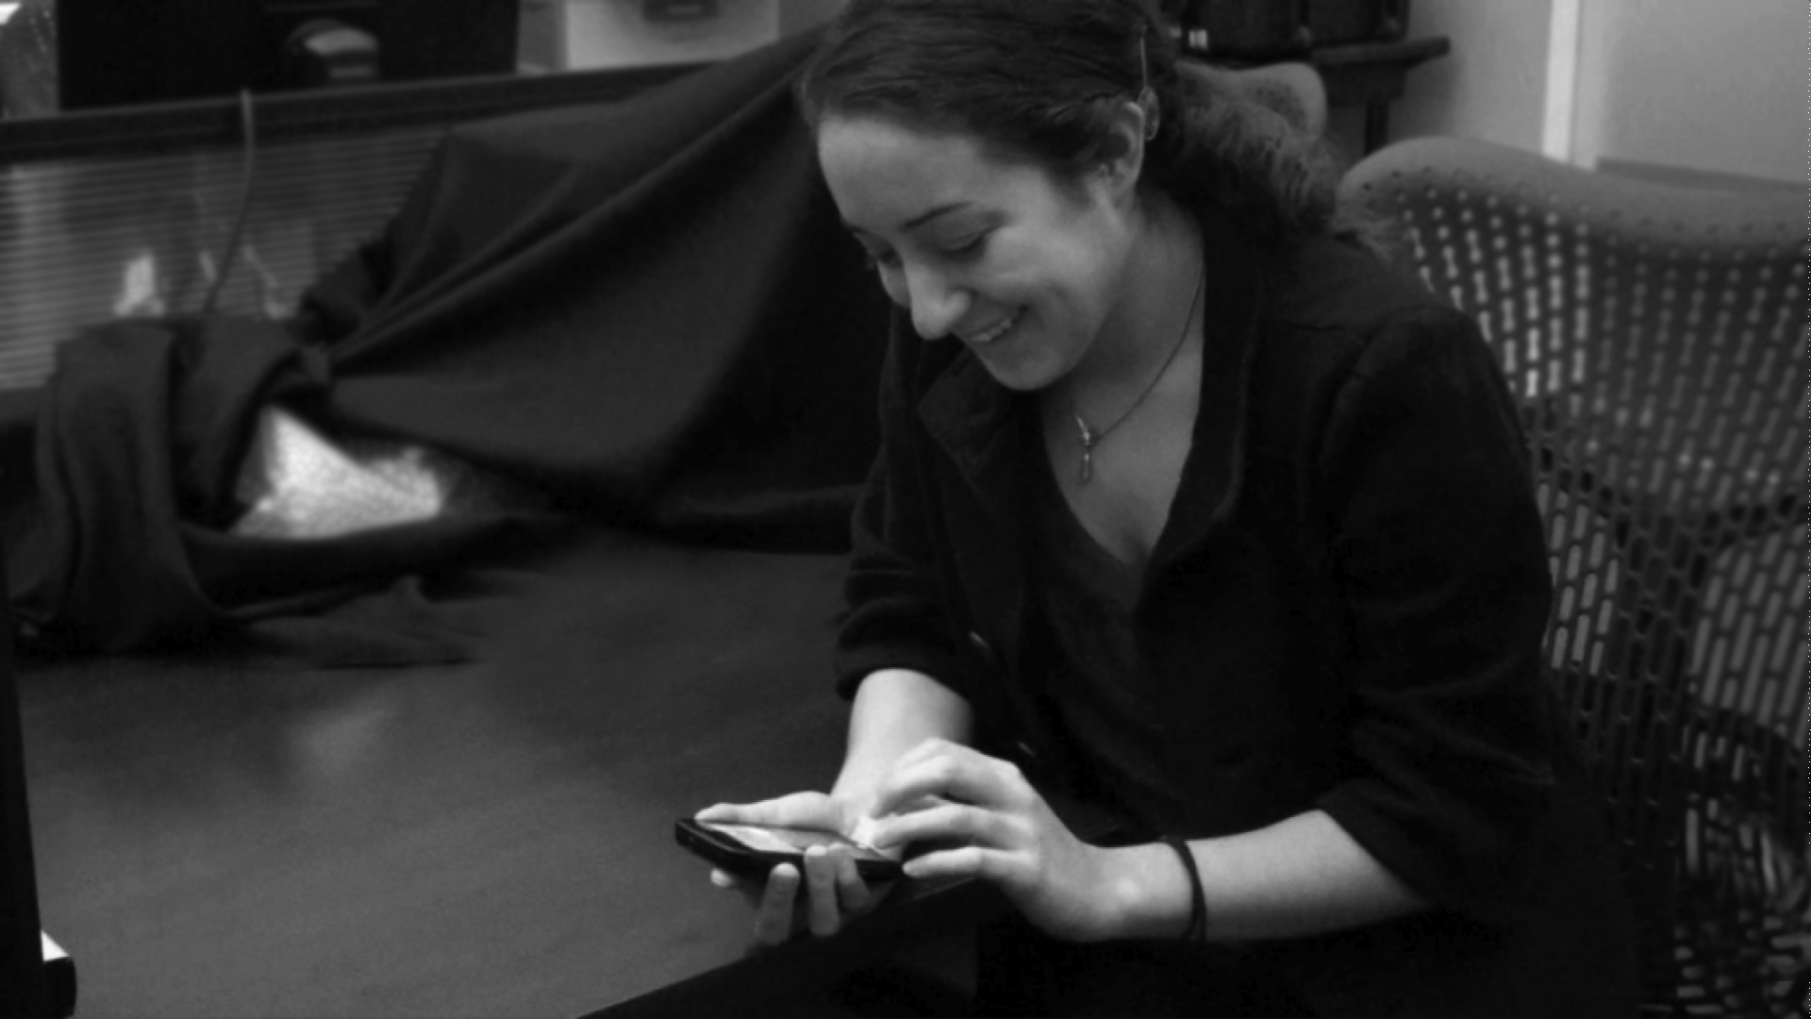
“Feeling the keys makes it easier to use a touchscreen without making mistakes.”
Jessica, 28, Accountant
© 2011 Immersion Corporation

Slide 30
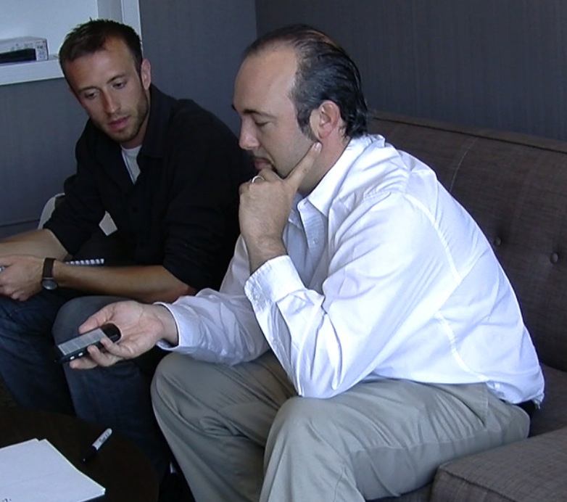
“I know what’s about to happen before it happens.”
Paul

Slide 31
Open Questions
How to quantify emotional engagement enabled by haptics?
What effect does haptic fidelity have on haptic enabled affect?

